Slide 1
Surveying I.
Lecture 1.
Sz. Rózsa: Surveying I. – Lecture 1

Slide 2
Outline
Introduction
Historical Surveying
Surveying - Science and Profession
Methods of height determination
Levelling
The surveyors’ level
Sz. Rózsa: Surveying I. – Lecture 1

Slide 3
Introduction
Lecturers:
Lectures
Dr. Szabolcs Rózsa
Department of Geodesy and Surveying,
K. building groundfloor 27.
Practicals
Dr. Tamás Tuchband
Department of Geodesy and Surveying
K. building groundfloor 27.
Mr Bence Ambrus
Department of Geodesy and Surveying
K. building groundfloor 27.
Sz. Rózsa: Surveying I. – Lecture 1

Slide 4
Introduction
Course details:
First part of a two-semester-course
3 hours/week (1 lecture + 2 practicals)
Communication:
Activities involve lectures, practicals, tutorials and a field practice
Lectures - provide the theoretical background of the topics
Practicals - practical sessions, in which You’ll carry out measurements and process them.
Tutorials - if there’s a need for additional guidance in the preparation for assessments. Please note that You have to arrange an appointment in due time.
Field practice - a 9-day-long intensive course after the course Surveying II.
Sz. Rózsa: Surveying I. – Lecture 1

Slide 5
Introduction
Attendance:
Please attend all scheduled lectures, seminars and practicals
Please note: attendance falling below 70% may lead to failing the course irrespective of the academic performance.
Sz. Rózsa: Surveying I. – Lecture 1

Slide 6
Introduction
Classroom tests:
Altogether 3 classroom assessments:
Practicals 1-4 (10 points) – no minimum req.
Using a theodolite – must pass
Final Test (involving the topics of the lectures, practicals) – 50 points – min 25 pts.
Course Evaluation:
Sz. Rózsa: Surveying I. – Lecture 1

Slide 7
Introduction
Learning resources:
The slides are available for download on the educational portal of the faculty:
http://edu.epito.bme.hu
However You shall write own notes during the lectures, too.
You’ll be suplied with computational sheets, field notes etc. during the course.
Textbook: A. Bannister - S. Raymond - R. Baker: Surveying (Seventh Edition, Prentice Hall, 1998)
Another electronic textbook under preparation, see the edu portal!
Sz. Rózsa: Surveying I. – Lecture 1

Slide 8
Outline
Introduction
Historical Surveying
Surveying - Science and Profession
Methods of height determination
Levelling
The surveyors’ level
Sz. Rózsa: Surveying I. – Lecture 1

Slide 9
Historical Surveying
What is Surveying?
The art of making measurements of the relative positions of natural and man-made features on the Earth’s surface, and the presentation of this information either graphically or numerically.
Since when?
The first surveying works date back to the antiquity, the Greek provided the first account of surveying techniques.
Euclid founded the theoretical background for surveying by the development of his geometry.
Sz. Rózsa: Surveying I. – Lecture 1

Slide 10
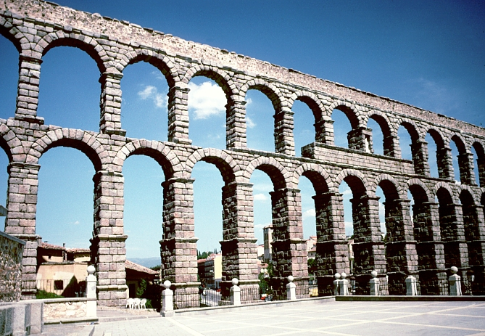
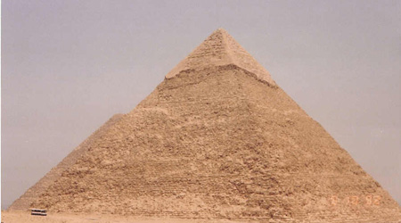
Historical Surveying
Sz. Rózsa: Surveying I. – Lecture 1

Slide 11
Outline
Introduction
Historical Surveying
Surveying - Science and Profession
Methods of height determination
Levelling
The surveyors’ level
Sz. Rózsa: Surveying I. – Lecture 1

Slide 12
Surveying - Science and Profession
Surveying vs. Geodesy
in most languages there are no distinctions between the terms
in English (according to Vanicek - Krakiwsky):
Surveying: the practice of positioning
Geodesy: the theoretical foundation of surveying
Geodesy is the scientific background of Surveying as a profession.
Sz. Rózsa: Surveying I. – Lecture 1

Slide 13
Surveying - Science and Profession
Surveying:
The art of making measurements of the relative positions of natural and man-made features on the Earth’s surface, and the presentation of this information either graphically or numerically.
Geodesy:
Geodesy is the discipline that deals with the measurements and representation of the Earth, including its gravity field, in a three-dimensional time varying space.
Geodesy focus on the Earth and neglect any man-made features on it (e.g. buildings, public utilities, etc.), while surveying use the results of geodesy for positioning and mapping of these features.
Sz. Rózsa: Surveying I. – Lecture 1

Slide 14
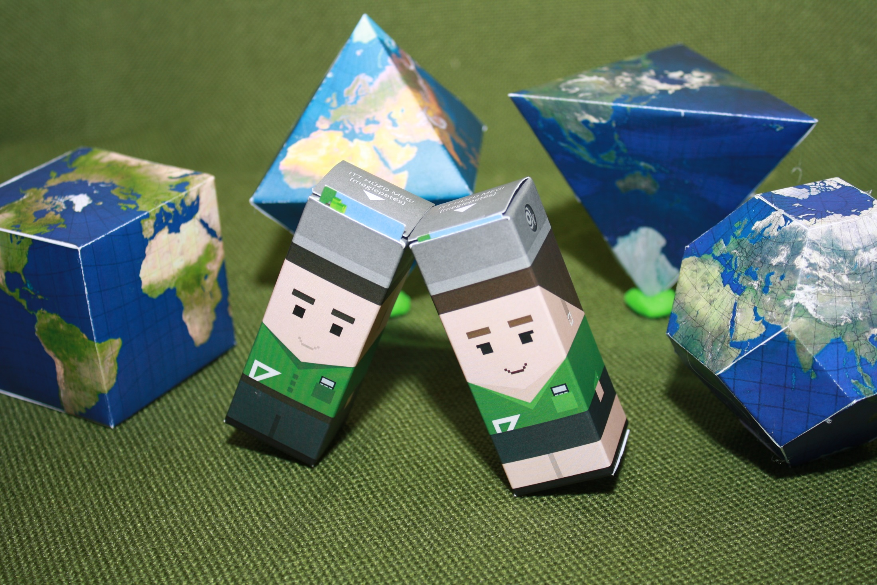
Historical Surveying
What is the shape of the Earth?
Sz. Rózsa: Surveying I. – Lecture 1

Slide 15
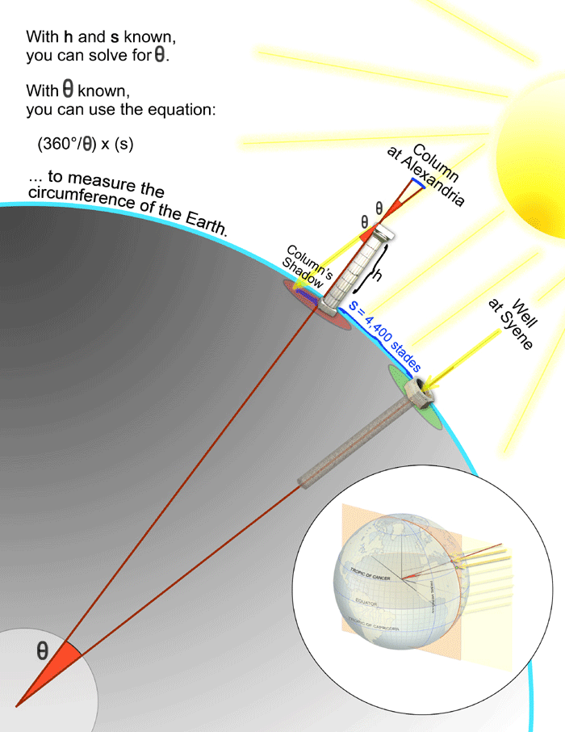
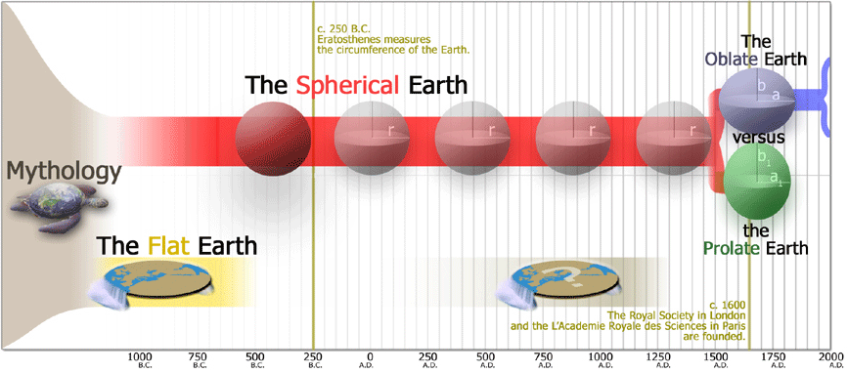
Historical Surveying
Eratosthenes (ca. 250 BC)
„Spherical Earth”
Sz. Rózsa: Surveying I. – Lecture 1

Slide 16
Geodesy as a science
The gravity field

Slide 17
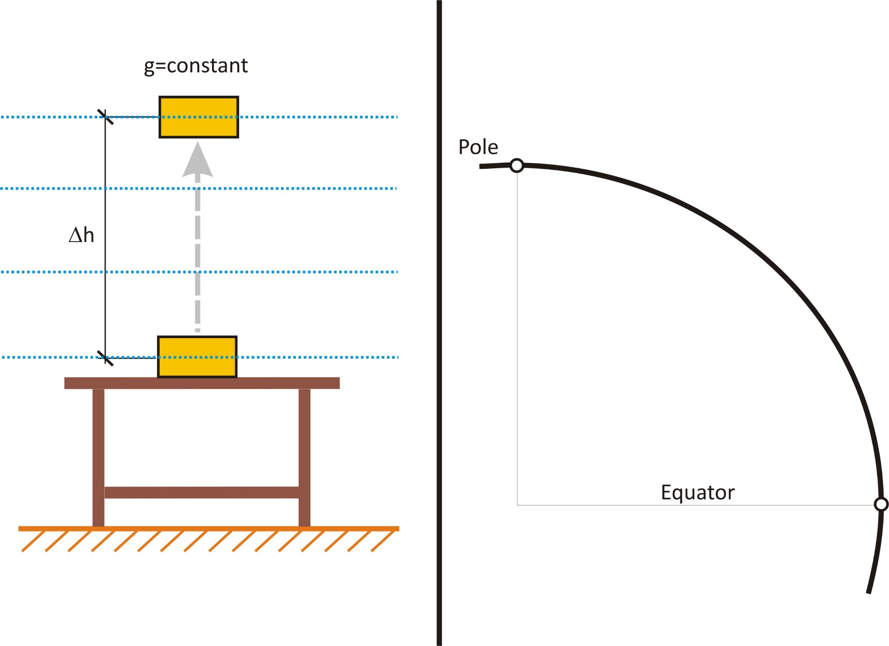
Geodesy as a science
Equipotential surfaces and plumb lines (direction of the vertical) of the gravity field

Slide 18
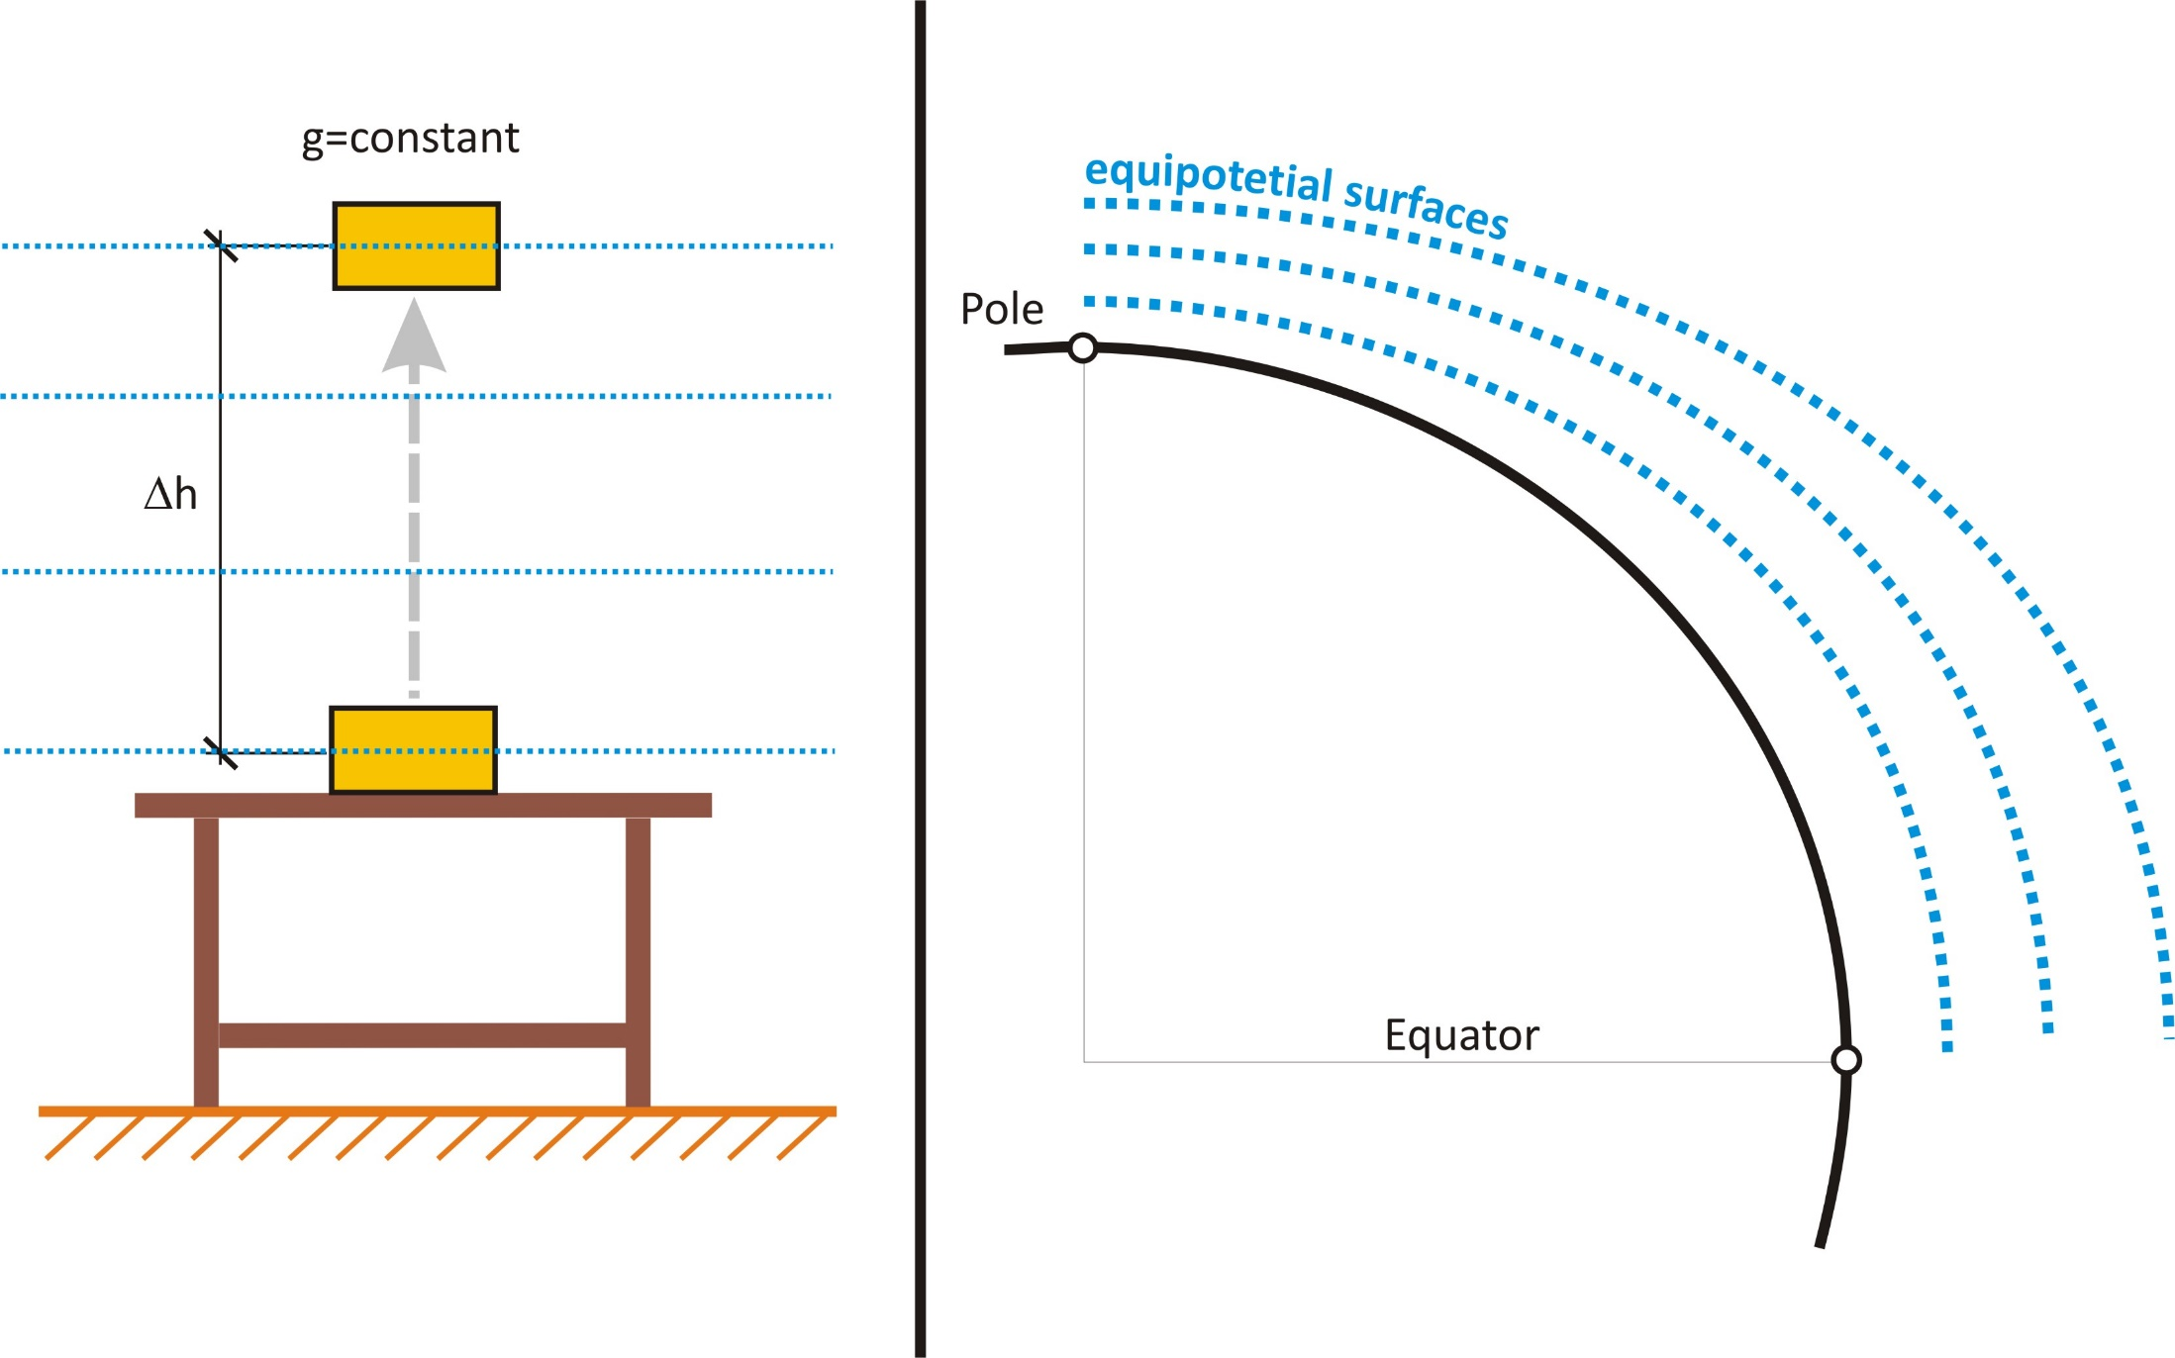
Geodesy as a science
Equipotential surfaces and plumb lines of the gravity field (solution)

Slide 19
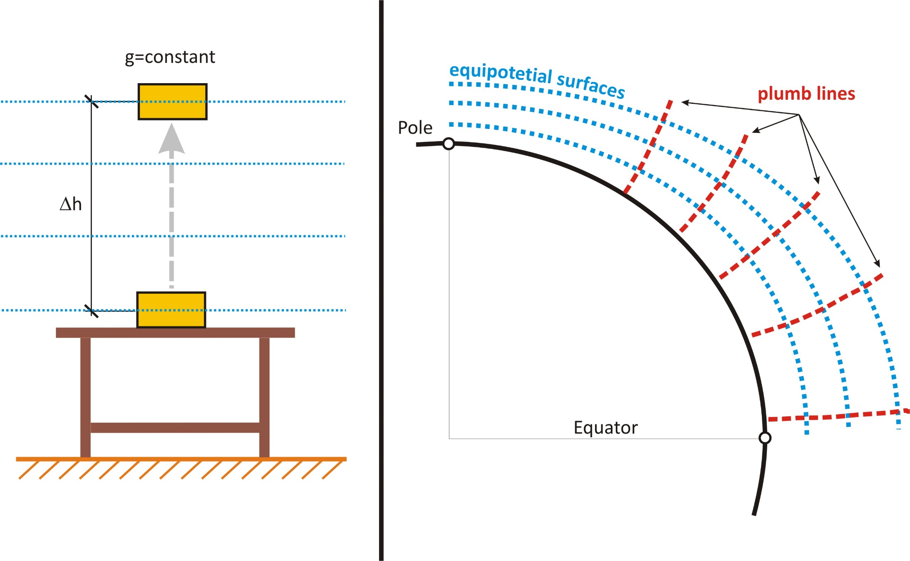
Geodesy as a science
Equipotential surfaces and plumb lines of the gravity field (solution)

Slide 20
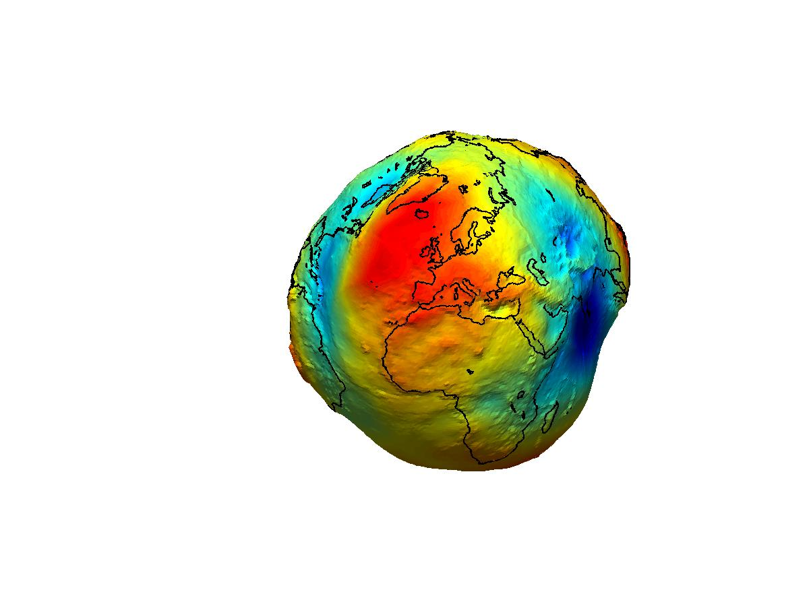
The shape of the Earth
The physical shape (true) of Earth:
surface formed by the continents and
the surface of the oceans
The mathematical (theoretical) shape of Earth
the shape of the open surface of liquid ocean, when only the gravity field affects it
→ geoid
Notes:
20

Slide 21
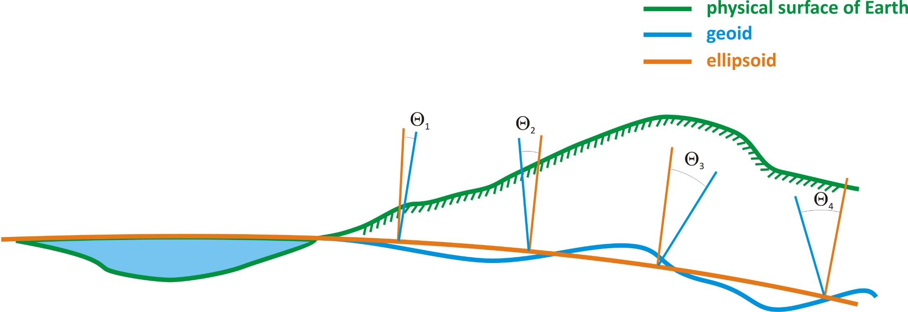
Positioning in geodesy/surveying
Coordinate system
Coordinates systems are established on reference surfaces
(ellipsoid, sphere, plane)

Slide 22
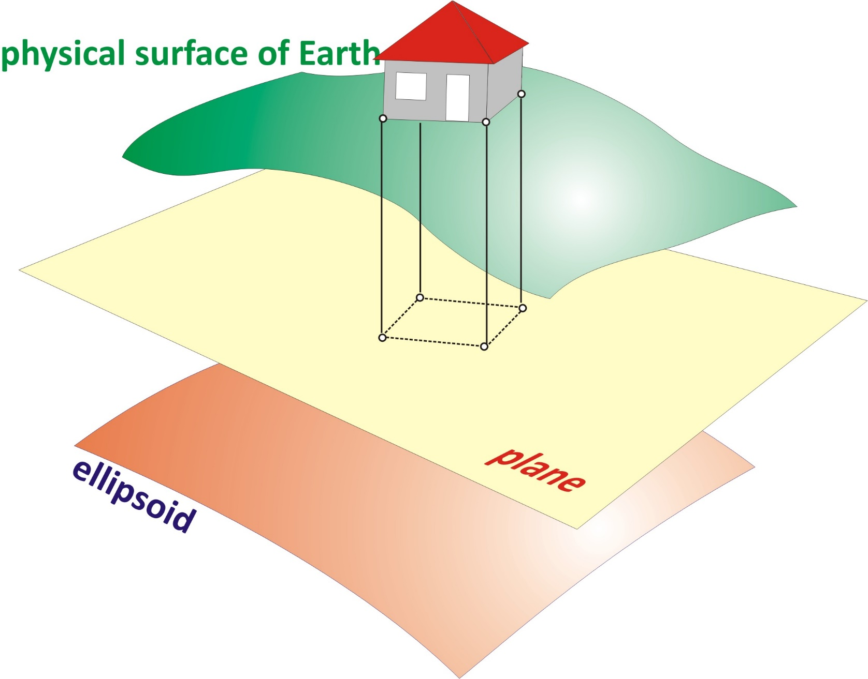
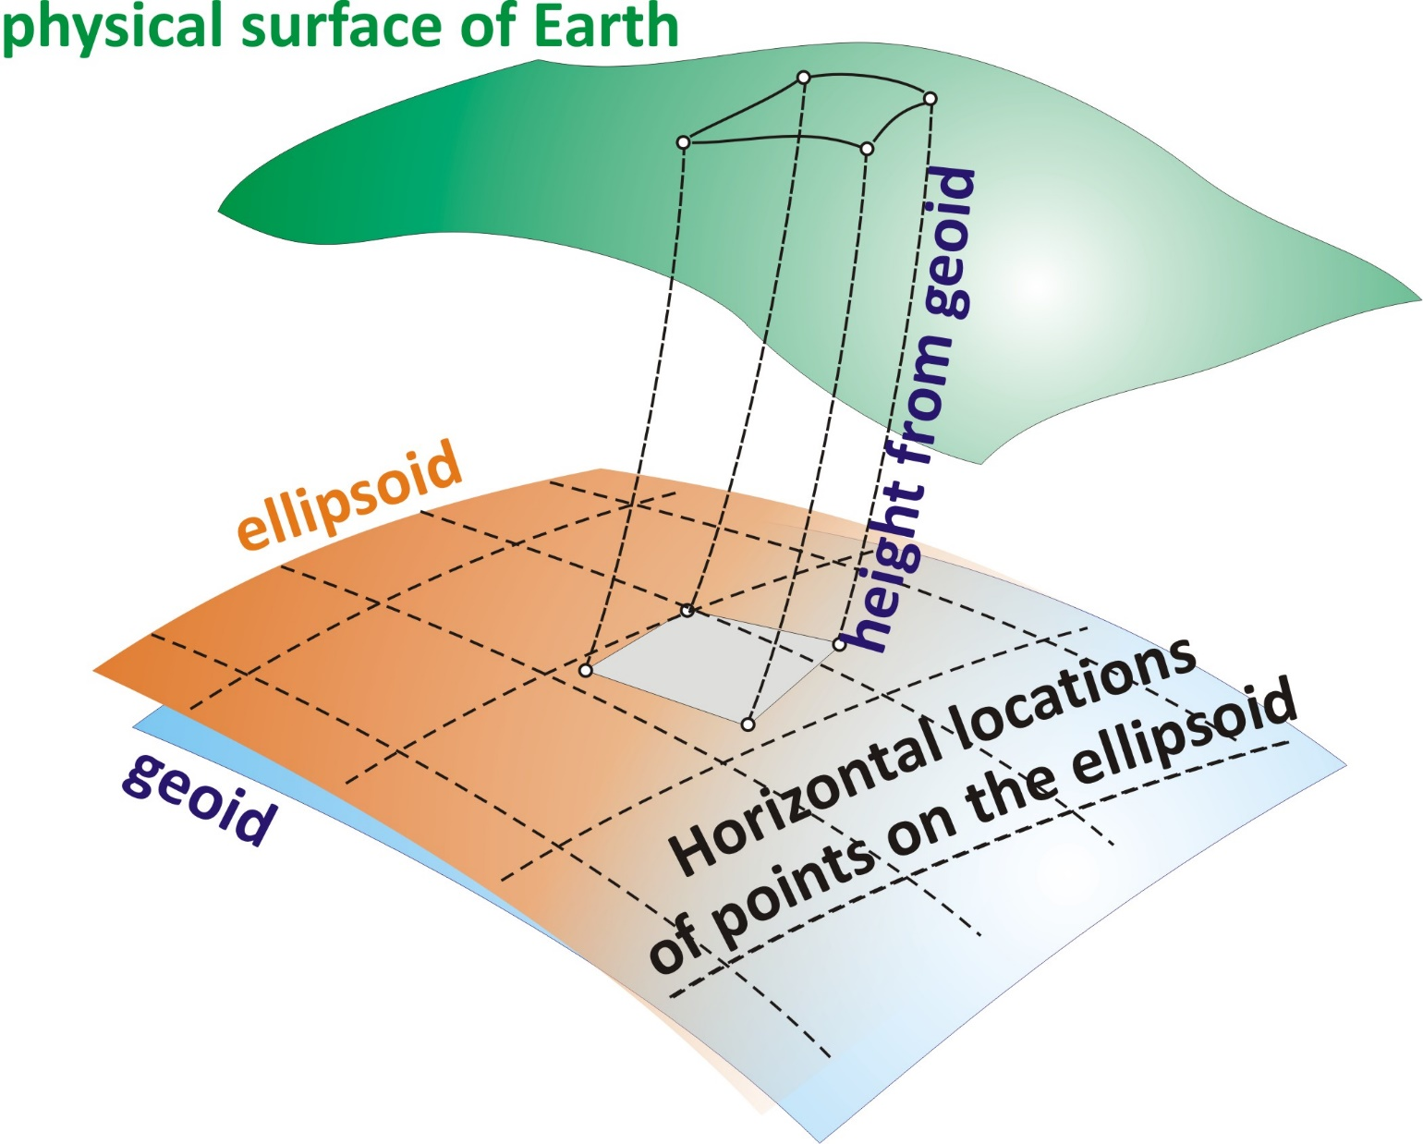
Positioning in Geodesy/Surveying

Slide 23
Outline
Introduction
Historical Surveying
Surveying - Science and Profession
Methods of height determination
Levelling
The surveyors’ level
Sz. Rózsa: Surveying I. – Lecture 1

Slide 24
Methods of height determination
Question 1:
What does the height (elevation) of a point mean?
Question 2:
What does it mean, when point B is at a higher elevation than point A?
Answer 1:
The height of a point represents its energy level above a reference level.
Answer 2:
For example water flows from point B to point A.
Sz. Rózsa: Surveying I. – Lecture 1

Slide 25
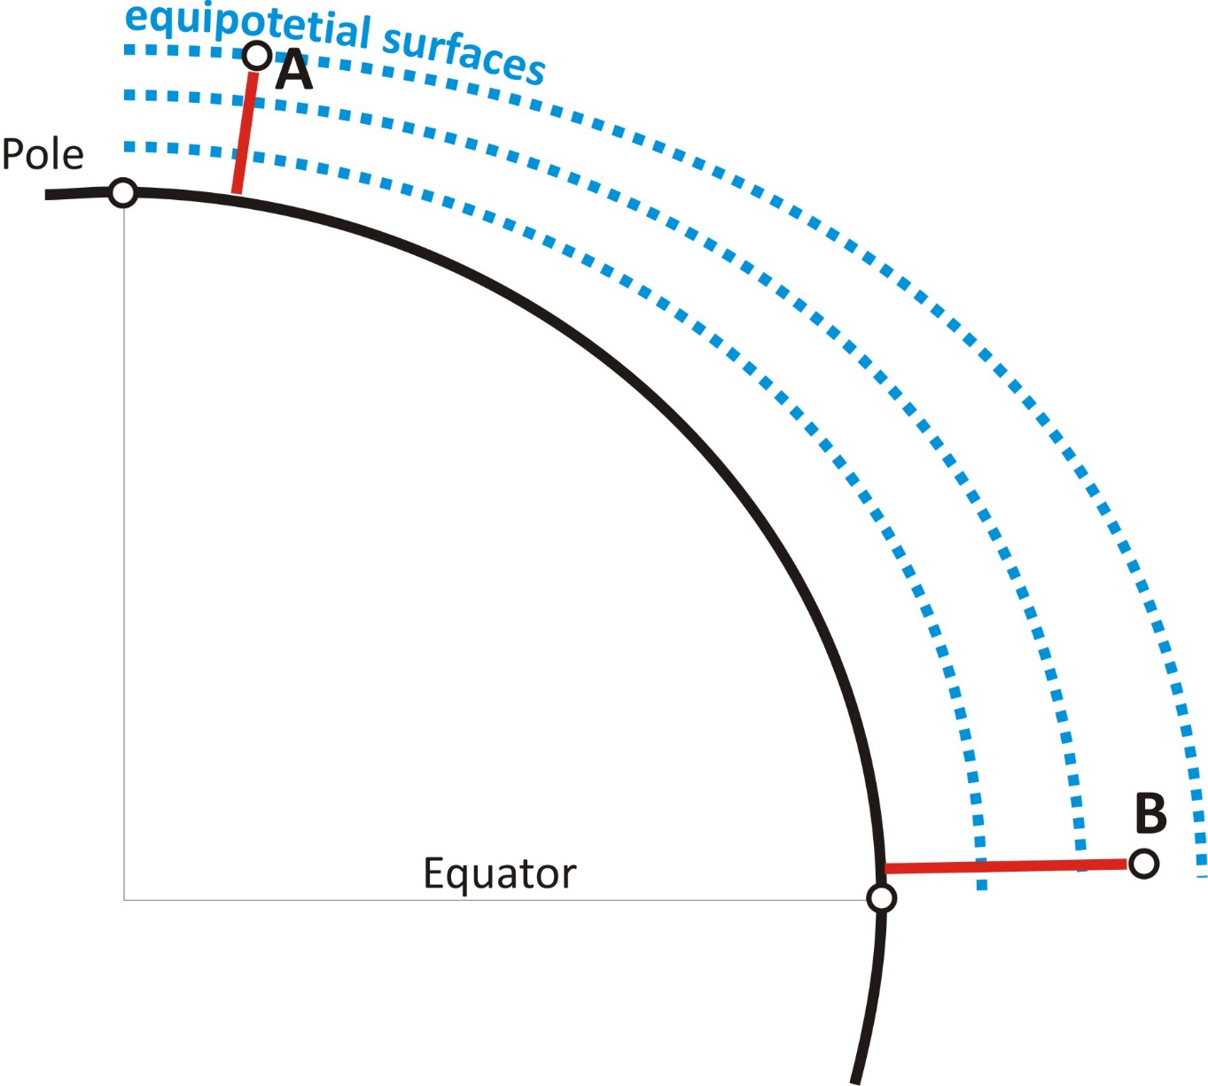
The definition of heights? What does it express?
Does water flow from A->B or B->A?

Slide 26
Solution: the water flows from A to B
Heights must reflect the potential of the gravity field at the point:
Thus:
[m²/s²]
Definition of Heights:
[m]

Slide 27
Methods of height determination
Definition of height systems:
The potential energy of a point should be represented by the height of a point. Hence water should flow from the higher elevation towards the lower elevation.
Should have metric unit.
What should be the reference of height determination? What is the 0 level?
Since the height systems should represent the potential energy level, we need a reference surface, which is an equipotential surface of Earth’s gravity field.
The surface of calm water forms an equipotential surface
Mean Sea Level – Kronstadt (Baltic Sea) is used in Hungary (formerly Triest, Adriatic Sea).
Sz. Rózsa: Surveying I. – Lecture 1

Slide 28
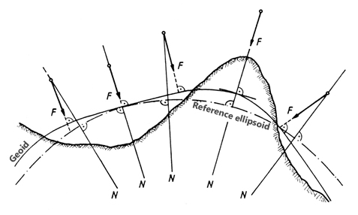
The definition of the ellipsoidal height / geoidal height
h = N + H
→ N the distance between the geoid and the ellipsoid
(one of the focus area of geodesy)
→ H the height above the geoid (sea level)
Notes:
28

Slide 29
Methods of height determination
1D position determination - determining the height
We can not determine absolute heights above the reference level
Relative height determination - determining the height differences
Levelling benchmarks are needed - control points for which the elevation is known.
Reference level
Sz. Rózsa: Surveying I. – Lecture 1

Slide 30
Methods of height determination
How can we determine the height difference?
Three solutions:
setting a horizontal plane, and measuring the offset from this plane
measuring the slope and slope distance between the points
physical methods of height determination (e.g. air pressure observation)
Levelling
Trigonometrical height determination
Reference level
Sz. Rózsa: Surveying I. – Lecture 1

Slide 31
Outline
Introduction
Historical Surveying
Surveying - Science and Profession
Methods of height determination
Levelling
The surveyors’ level
Sz. Rózsa: Surveying I. – Lecture 1

Slide 32
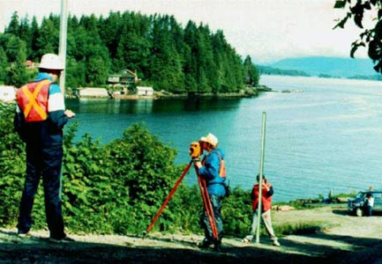
Levelling
Sz. Rózsa: Surveying I. – Lecture 1

Slide 33
The principle of levelling
Line of sight
δ_{A}
δ_{B}
(l_{A})
l_{A}
equipotential
surface
A
(l_{B})
l_{B}
ΔH_{AB}
topography
ΔH_{AB}=l_{A}-l_{B}=(l_{A})-δ_{A}-(l_{B})+δ_{B}
B
When δ_{A}=δ_{B} (spherical approximation, equal distance to A and B)
ΔH_{AB}=(l_{A})-(l_{B})
Sz. Rózsa: Surveying I. – Lecture 2

Slide 34
The Surveyor’s level
Tilting level
Bubble tube
Diaphragm
Tilting screw
Tilting axis
Circular bubble
Levelling head
Clamping screw - to fix the telescope in one vertical plane
Tangent screw (slow motion screw) - to finely rotate the telescope along a vertical axis
Sz. Rózsa: Surveying I. – Lecture 2

Slide 35
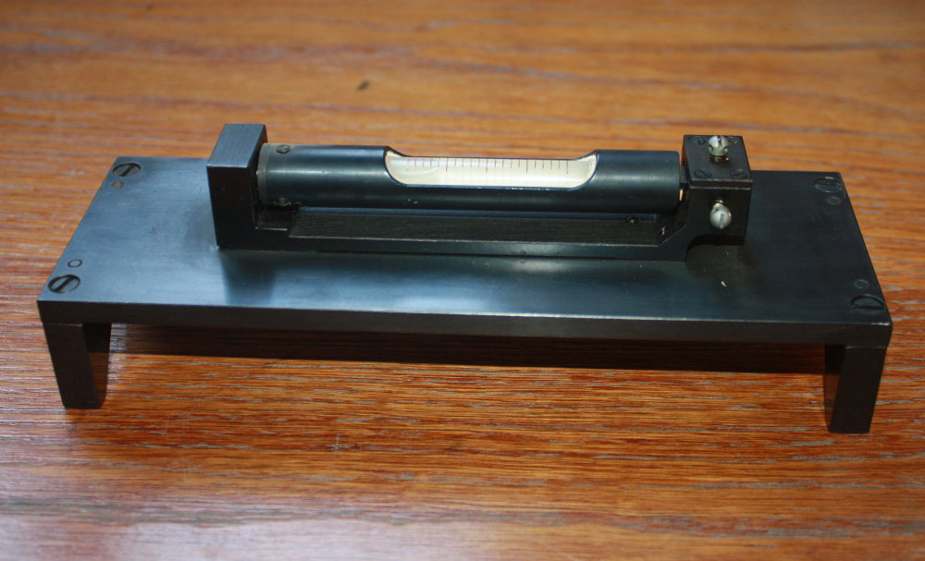
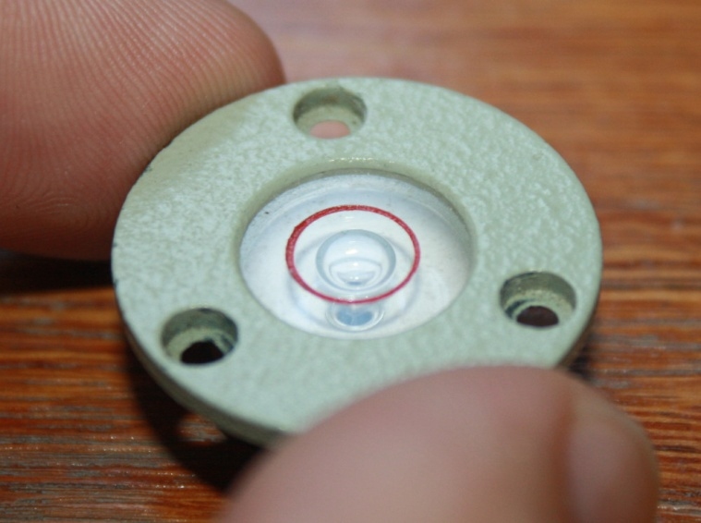
The structure of the tilting level – bubble tube/circular bubble

Slide 36
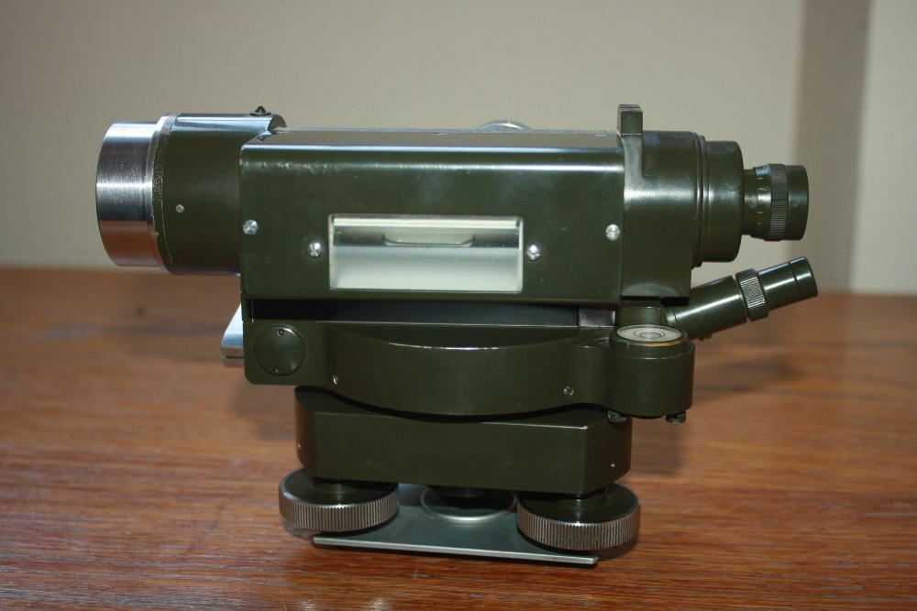
The tilting level

Slide 37
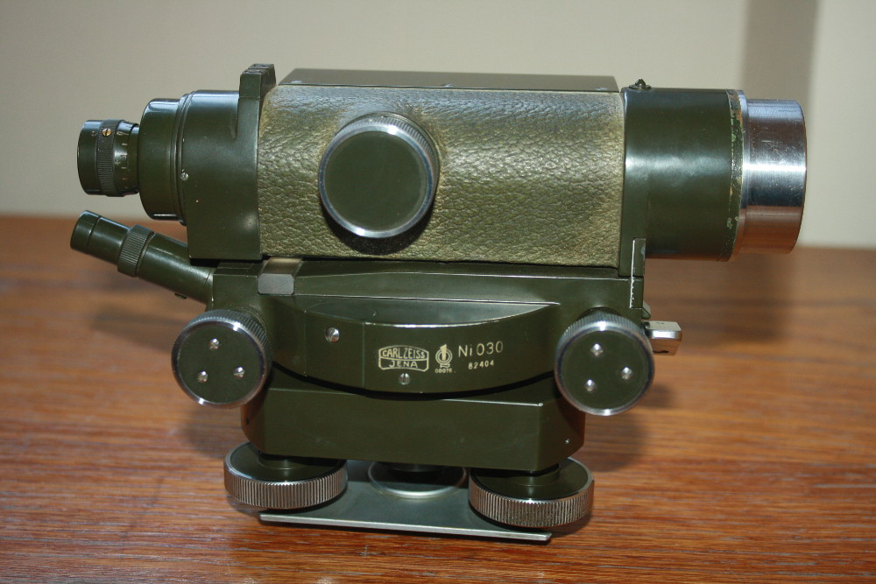
The tilting level

Slide 38
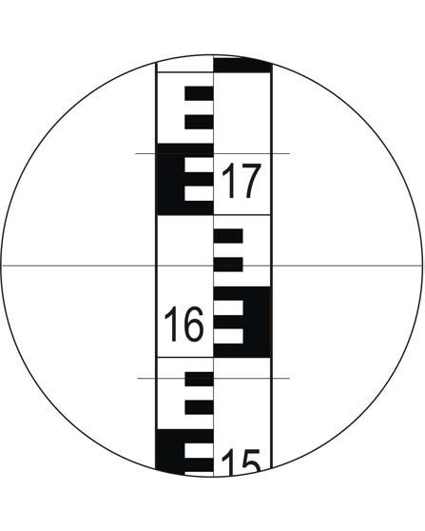
Levelling staff
Reading: 1663

